Slide 1
2. Boolean Algebra and Logic Gates

Slide 2
2.1 Boolean Algebra and Logic Gates
Boolean Algebra
  Define
    a set of elements, a set of operators
    a number of unproved axioms or postulates

Slide 3
2.2 Basic Definition
Various algebraic structures
1. Closure : A set S is closed with respect to a binary operator if, for every pair of elements of S, the binary operator specifies a rule for obtaining a unique elements of S.
2. Associative law : (x*y)*z=x*(y*z) for all x,y,z∈S
3. Commutative law : x*y=y*x for all x,y∈S
4. Identity elements: for all x∈S, e*x=x*e=x
ex) set of integers I={…, -3, -2, -1, 0, 1, 2, 3, …}, x+0=0+x=x
5. Inverse : A set S having the identity elements
for all x∈S , y∈S, x*y=e
6. Distributive law : x*(y • z)=(x*y) • (x*z)

Slide 4
2.3 Axiom Definition of Boolean Algebra
Boolean algebra is an algebraic structure defined by a set of elements, B, together with two binary operators, + and·, provided that the following(Huntington) postulates are satisfied
(a) Closure with respect to the operator +.
(a) Closure with respect to the operator ·.
(a) An identity element with respect to +, designated by 0: x+0=0+x=x
(b) An identity element with respect to ·, designated by 1: x·1=1·x=x
(a) Commutative with respect to + : x + y = y + x
(a) Commutative with respect to · : x · y = y · x
(a) · is distributive over + : x·(y+z)=(x·y)+(x·z)
(a) + is distributive over · : x+(y·z)=(x+y) ·(x+z)
For every element xєB, there exists an element x’ єB such that (a)x+x’=1 and (b) x·x’ = 0
There exists at least two elements x, y єB such that x≠y

Slide 5
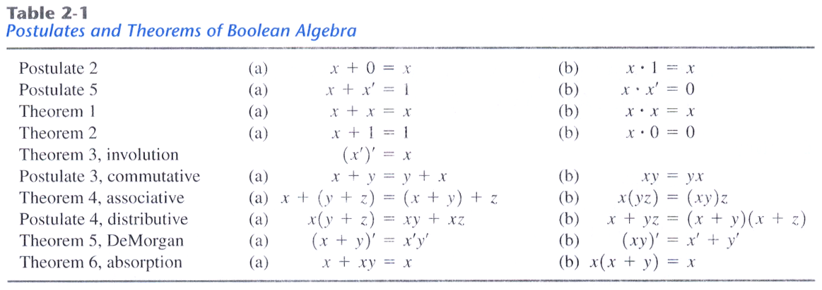
2.4 Basic Theorems and Properties of Boolean Algebra
Duality
- interchange OR and And operators and replace 1’s by 0’s and 0’s by 1’s
Operator precedence
1. Parentheses
2. NOT
3. AND
4. OR

Slide 6
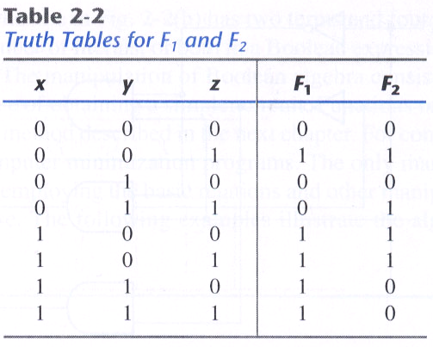
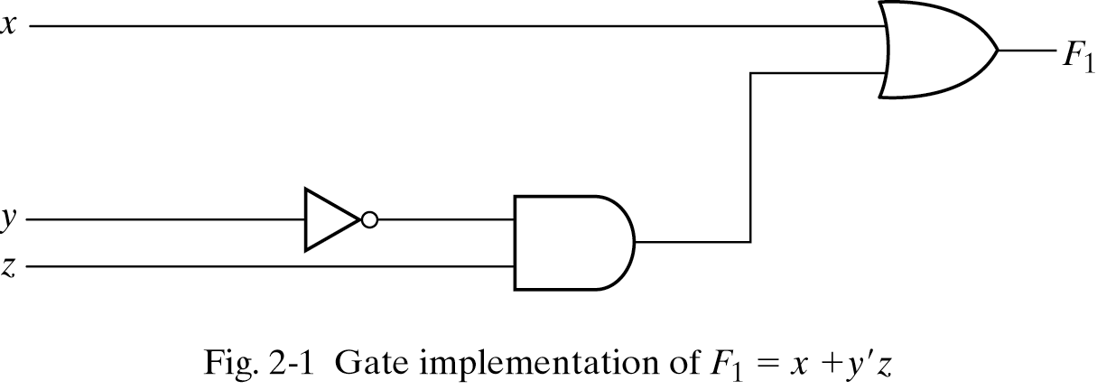
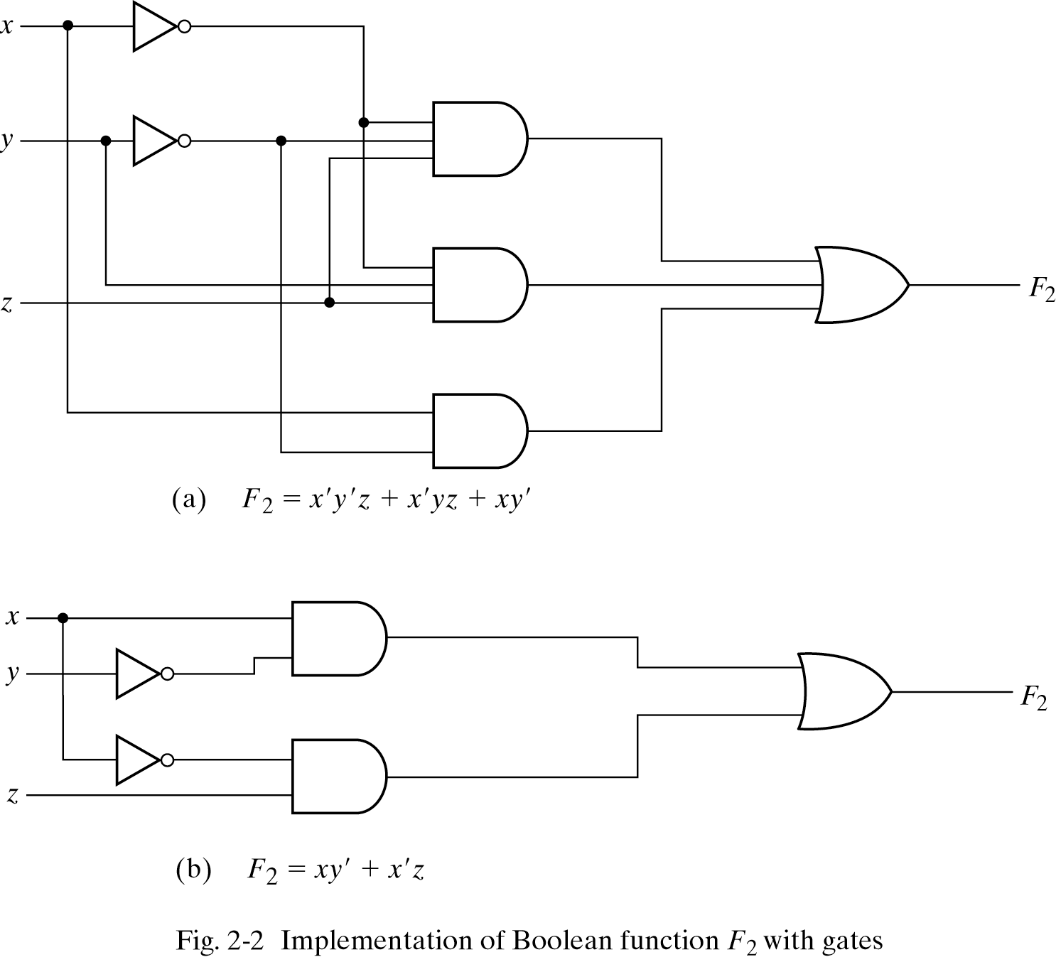
2.5 Boolean Functions
F₁ = x + y'z
F₂ = x'y'z + x'yz +xy‘
= x'z(y'+y) + xy'
= x'z + xy'

Slide 7
2.5 Boolean Functions – Algebraic Manipulation
Ex 2-1) Simplify the following Boolean functions to a minimum number of literals.
1. x(x'+y) = xx' + xy = 0 + xy = xy.
2. x +x'y = (x+x')(x+y) = 1(x+y) = x + y.
3. (x+y)(x+y') = x + xy + xy' + yy' = x(1+y+y') = x.
4. xy + x'z + yz = xy + x'z + yz(x+x')
= xy + x'z + xyz + x'yz
= xy(1+z) + x'z(1+y)
= xy + x'z
5. (x+y)(x'+z)(y+z) = (x+y)(x'+z) : by duality from function 4.
(A + B + C)'= (A+x)' let B+C=x
= A'x' by theorem 5(a)(DeMorgan)
= A'(B+C)' substitute B+C=x
= A'(B'C') by theorem 5(a)(DeMorgan)
= A'B'C' by theorem 4(b)(associative)
→ (A+B+C+D+…+F)' = A'B'C'D'…F'
(ABCD…F)' = A' +B'+ C' + D' + … + F'

Slide 8
2.5 Boolean Functions – Complement of a Function
Ex 2-2) Find the complement of the functions
F₁=x'yz'+x'y'z, F₂=x(y'z'+yz).
F₁' = (x'yz'+x'y'z)' = (x'yz')'(x'y'z)' = (x+y'+z)(x+y+z')
F₂' = [x(y'z'+yz)]' = x'+(y'z'+yz)' = x'+(y'z')'(yz)' = x'+(y+z)(y'+z')
Ex 2-3) Find the complement of the functions F₁ And F₂ Ex 2-2 by taking their duals and complementing each literal.
1. F₁ = x'yz' + x'y'z.
The dual of F₁ is (x'+y+z')(x'+y'+z)
Complement each literal : (x+y'+z)(x+y+z')=F₁'
2. F₂ = x(y'z'+yz).
The dual of F₂ is x+(y'+z')(y+z)이다.
Complement each literal : x'+(y+z)(y'+z')=F₂'

Slide 9
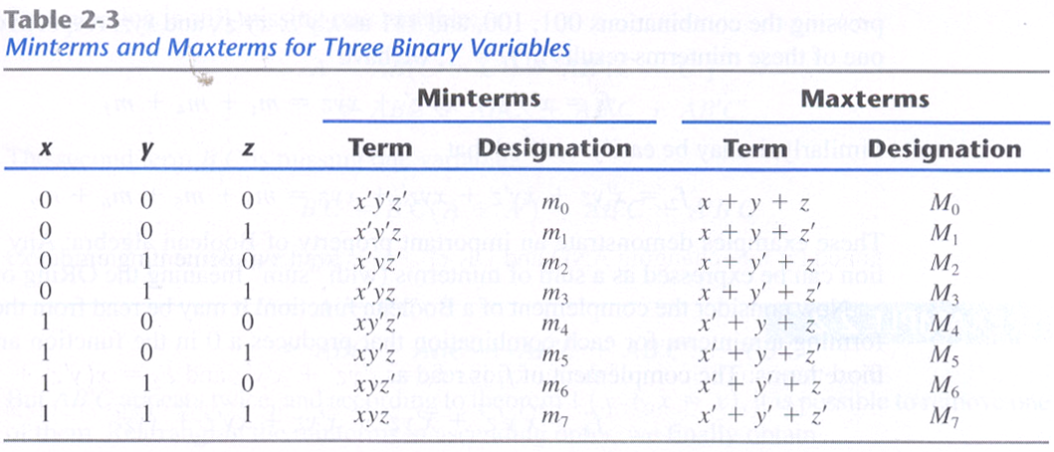
2.6 Canonical and Standard Forms
Minterms and Maxterms

Slide 10
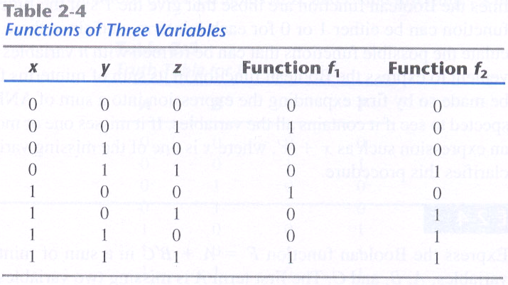
2.6 Canonical and Standard Forms
f₁ = x'y'z+xy'z'+xyz = m₁+m₄+m₇
f₂ = x'yz+xy'z+xyz'+xyz = m₃+m₅+m₆+m₇
f₁ = (x+y+z)(x+y'+z)(x'+y+z')(x'+y'+z)
= M₀M₂M₃M₅M₆
f₂ = (x+y+z)(x+y+z‘)(x+y'+z)(x'+y+z)
= M₀M₁M₂M₄

Slide 11
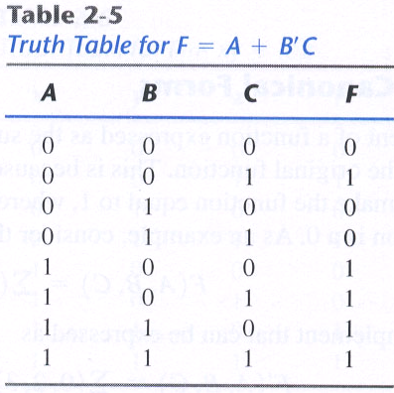
2.6 Canonical and Standard Forms
Sum of Minterms
Ex 2-4) Express the Boolean function F=A+B'C in a sum of minterms.
A = A(B+B') = AB +AB'
= AB(C+C') + AB'(C+C')
= ABC + ABC' + AB'C +AB'C'
B'C = B'C(A+A') = AB'C + A'B'C
F = A + B'C
= A' B'C + AB'C' + AB'C + ABC' + ABC
= m₁ + m₄ + m₅ + m₆ + m₇
_{= ∑(1, 4, 5, 6, 7)}

Slide 12
2.6 Canonical and Standard Forms
Product of maxterms
Ex 2-5) Express the Boolean function F = xy + x'z in a product of maxterm form.
F = xy + x'z = (xy+x')(xy+z)
= (x+x')(y+x')(x+z)(y+z)
= (x'+y)(x+z)(y+z)
x' + y= x' + y + zz'= (x'+y+z)(x'+y+z')
x + z= x + z + yy'= (x+y+z)(x+y'+z)
y + z= y + z + xx'= (x+y+z)(x'+y+z)
F = (x+y+z)(x+y'+z)(x'+y+z)(x'+y+z')
= M₀M₂M₄M₅
F(x, y, z) = ∏(0, 2, 4, 5)

Slide 13
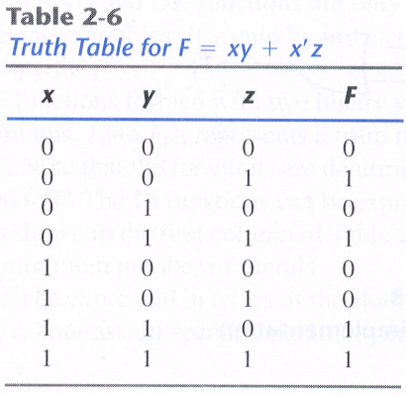
2.6 Canonical and Standard Forms
Conversion between Canonical Forms
F(A, B, C) = ∑(1, 4, 5, 6, 7)
F' (A, B, C) = ∑(0, 2, 3) = m₀ + m₂ + m₃
F = (m₀+m₂+m₃)' = m₀'m₂'m₃' = M₀M₂M₃ = ∏(0, 2, 3) , m_{j}' = M_{j}
Ex) F = xy + x'z
F(x, y, z) = ∑(1, 3, 6, 7)
F(x, y, z) = ∏(0, 2, 4, 5)

Slide 14
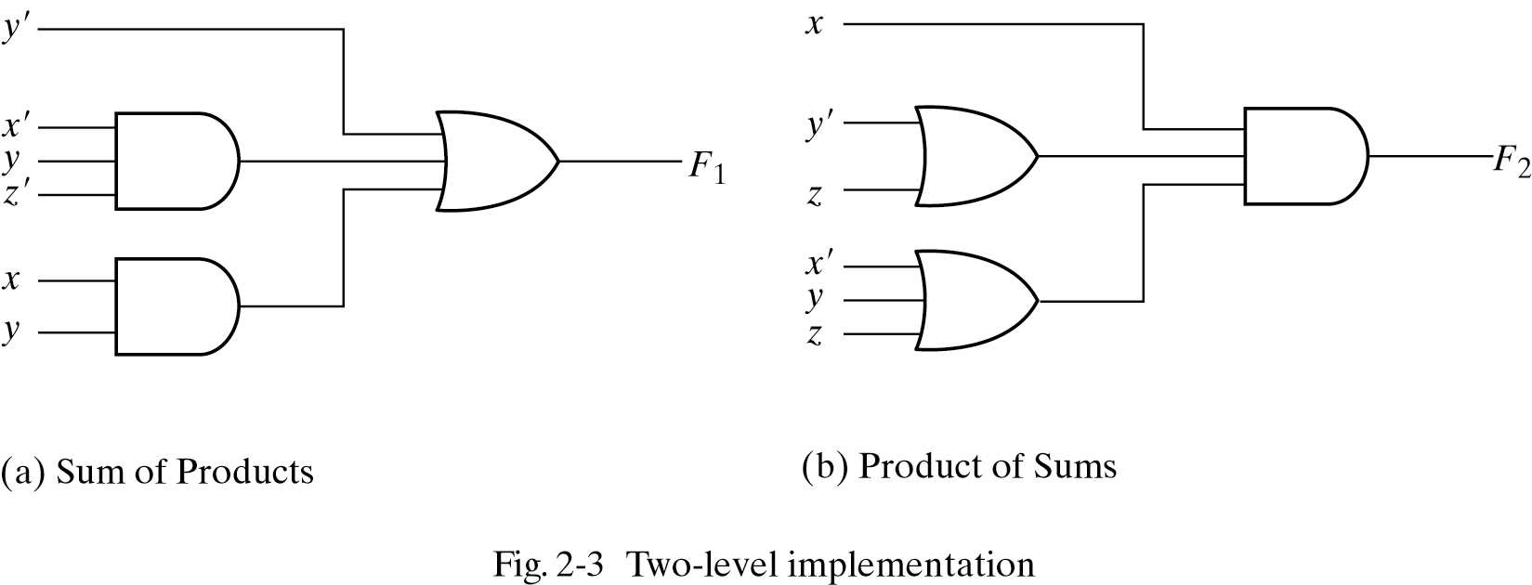
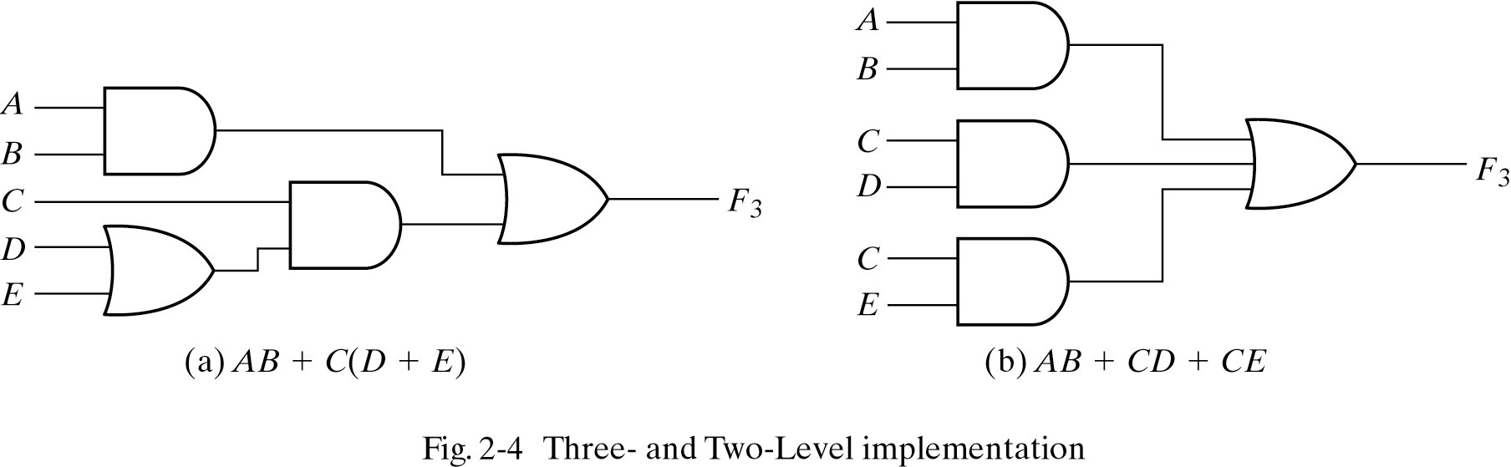
2.6 Canonical and Standard Forms
Standard Forms
- Sum of product : F₁ = y' +xy + x'yz'
- Product of sum : F₂ = x(y'+z)(x'+y+z'+w)
- Ex) F₃ = AB + C(D+E) = AB +CD + CE

Slide 15
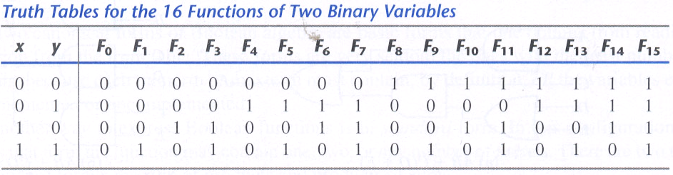
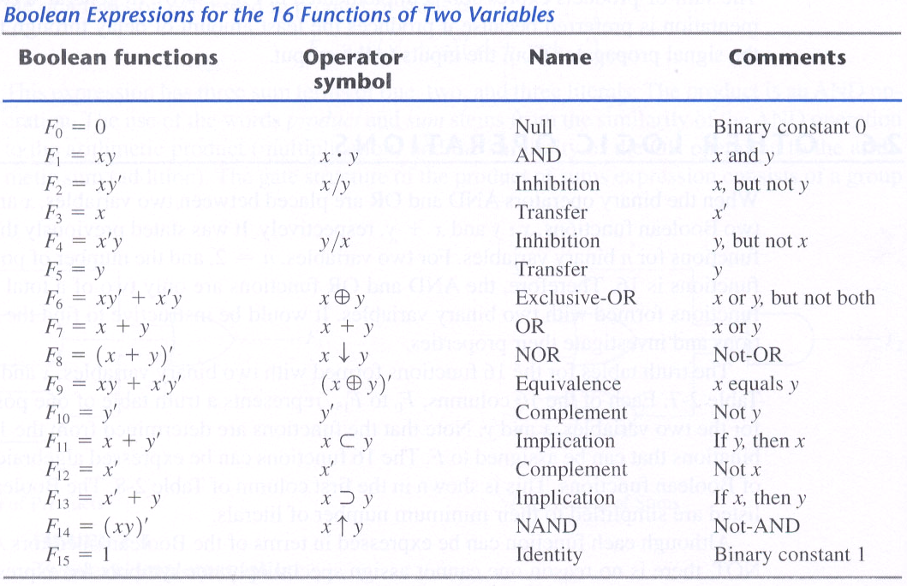
2.7 Other Logic Operations

Slide 16
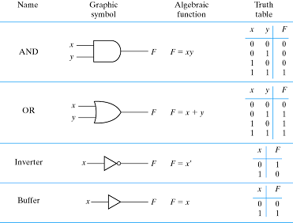
2.8 Digital Logic Gate

Slide 17
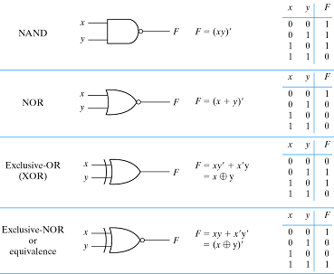
2.8 Digital Logic Gate

Slide 18
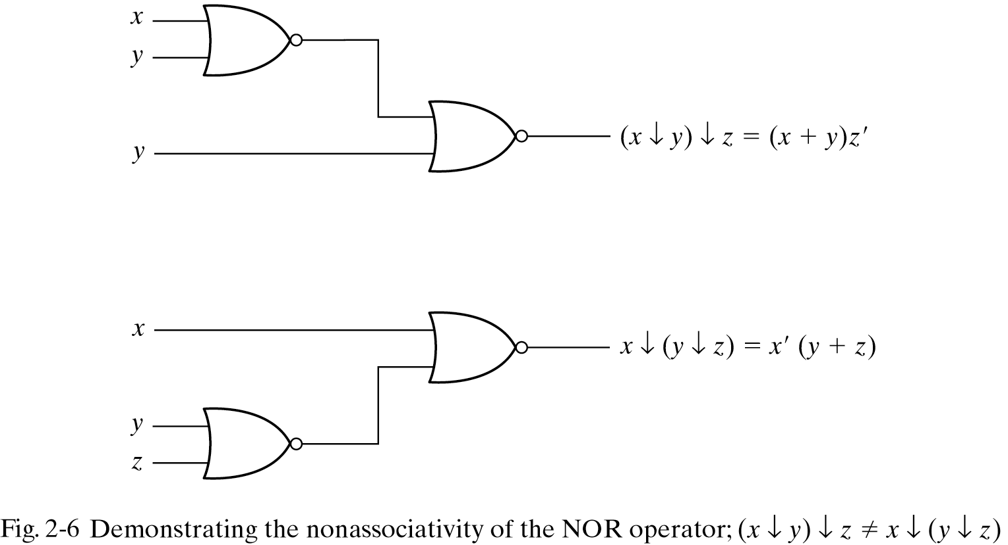
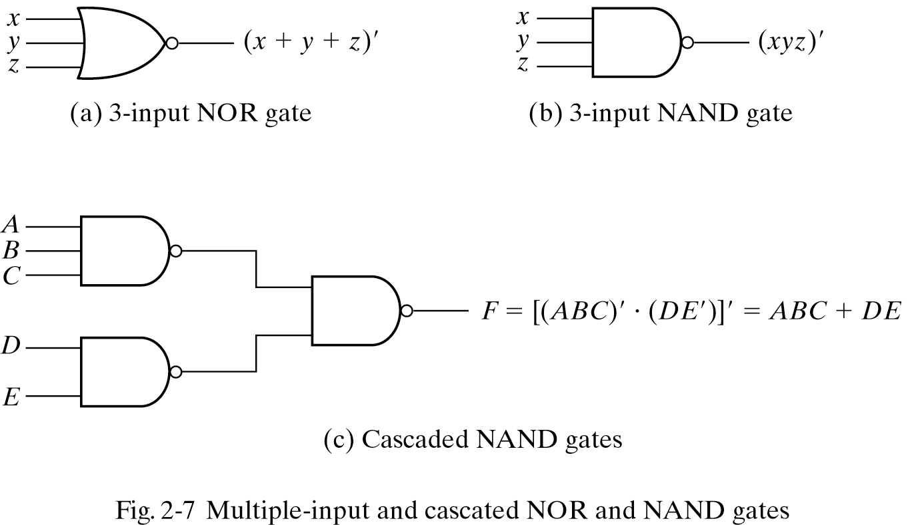
2.8 Digital Logic Gate
Extension to Multiple Inputs
- The NAND and NOR operators are not associative.
(x↓y)↓z≠x↓(y↓z)
(x↓y)↓z= [(x+y)'+z]'
= (x+y)z'= xz' + yz'
x↓(y↓z)= [x+(y+z)'] '
= x'(y+z)= x'y + x'z
x↓y↓z= (x+y+z)'
x↑y↑z= (xyz)'
F = [(ABC)'(DE)']' = ABC + DE

Slide 19
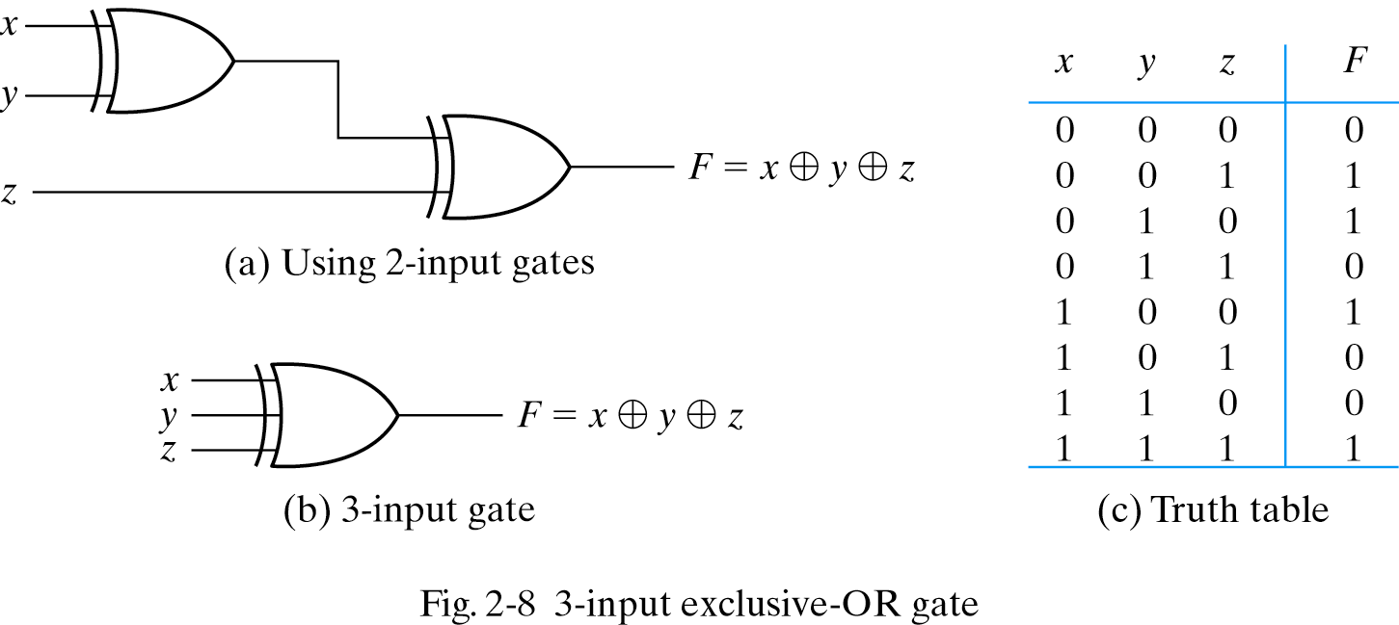
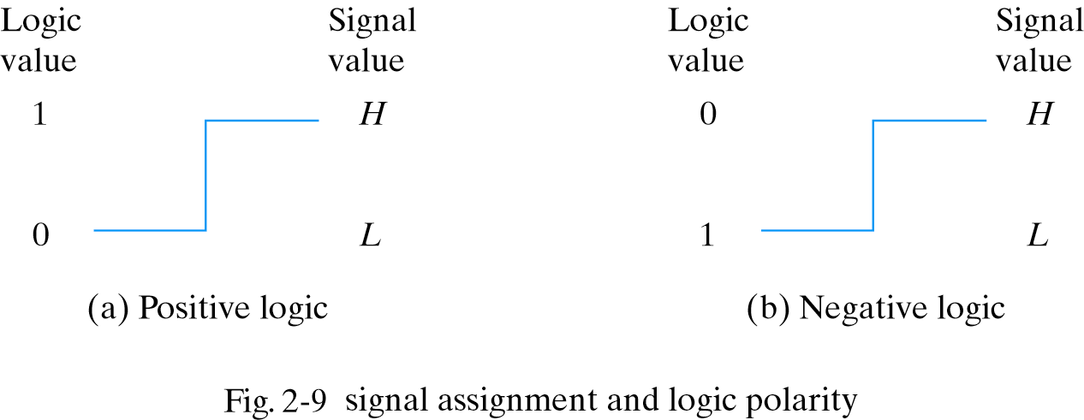
2.8 Digital Logic Gate
- exclusive-OR
Positive and Negative Logic

